Slide 1

ANALYSIS OF RAINFALL PREDICTION
Project Supervisor: Dr.SANKARI.M, M.E., Ph.D.,
Name of the Student: CHALLAGUNDLA GOPIKRISHNA
Register Number: 40110233
CSE-B5 SECTION(2020-24)

Slide 2

Presentation Outline
Introduction
Objectives
System Architecture / Ideation Map
Module Implementation
Application Snapshots
Results and Discussions
Conclusion
References

Slide 3

Introduction
Rainfall play important role in forming of fauna and flora of natural life.
It is not just significant for the human beings but also for animals, plants and all living things.
It plays a significant role in agriculture and farming and undoubtedly; water is one of the most natural resources on earth.
The changing climatic conditions and the increasing greenhouse emissions have made it difficult for the human beings and the planet earth to experience the necessary amount of rainfall that is required to satisfy the human needs and its uninterrupted use in everyday life.

Slide 4
Introduction(cont..)
Therefore, it has become significant to analyze the changing patterns of the rainfall and try to predict the rain not just for the human needs but also to predict for natural disasters that could cause by the unexpected heavy rainfalls.
To be more specific and aware of the devastating climatic changing and stay updated; predicting rainfall has been the focus of computer scientist and engineers.
This study is focusing on predicting rainfall using Linear Regression ,Random Forest and LASSO regression.
The rainfall prediction will not just assist in analyzing the changing patterns of rainfall but it will also help in organizing the precautionary measures in case of disaster and its management.

Slide 5
Objective
The Goal of the project id to predict the Rainfall using ML models with past data.
The major aim of the study is to develop and compare several ML models namely: linear regression , LASSO regressor , Ridge models for the prediction of the rain fall.
Secondly the study is also accesses and evaluate different scenarious and the effective of algrothims.
This study is vital to enhance the water management especiallly in godavari river.

Slide 6
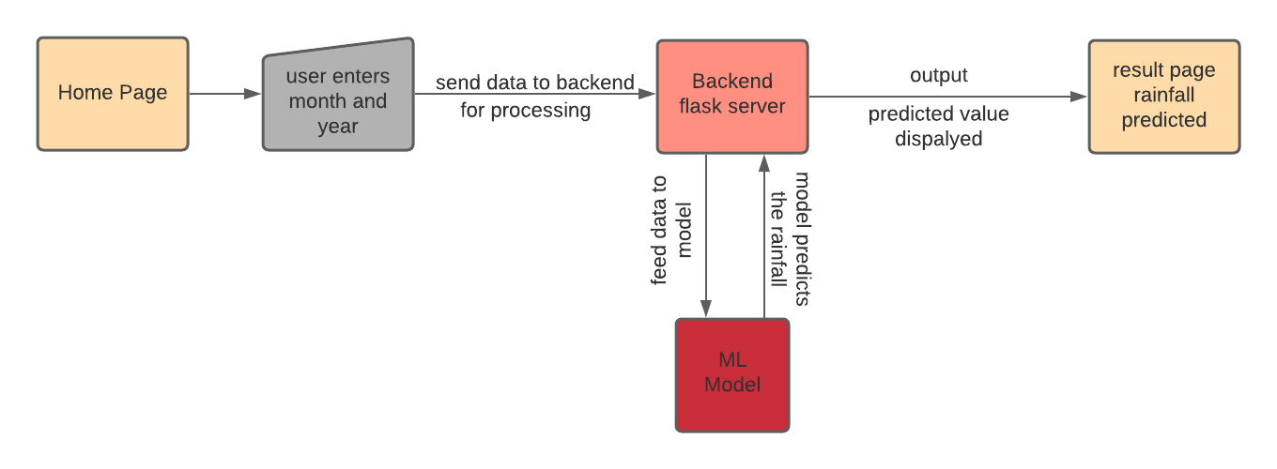
System Architecture Of Rainfall Prediction

Slide 7
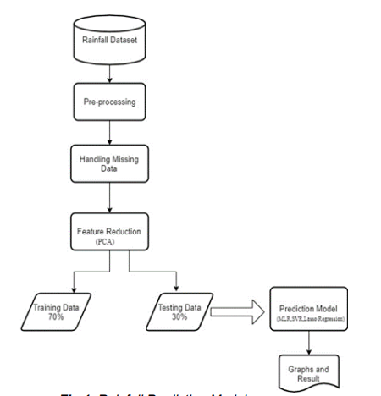
Project Design OF Rainfall Prediction

Slide 8




Hardware and software requirements
Hardware requirements: A laptop with a good internet connection.
Software Requirements:Anaconda software and Jupyter notebook

Slide 9
Modules Implementation
Modules | Definition
numpy | It supports large, multi-dimensional arrays and matrices, along with a large collection of high-level mathematical functions to operate on these arrays.
pandas | pandas is a software library written for the Python programming language for data manipulation and analysis.
matplotlib | Matplotlib is a plotting library for the Python programming language and its numerical mathematics extension NumPy.
seaborn | Seaborn is a Python data visualization library based on matplotlib. It provides a high-level interface for drawing attractive and informative statistical graphics.
sklearn | Scikit-learn is a free software machine learning library for the Python programming language.
math | Built-in module that you can use for mathematical tasks.

Slide 10
Methodology and Algorithm
LINEAR REGRESSION
Linear Regression is a machine learning algorithm based on supervised learning.
It performs a regression task.
Regression models a target prediction value based on independent variables.
It is mostly used for finding out the relationship between variables and forecasting.
Different regression models differ based on – the kind of relationship between dependent and independent variables they are considering, and the number of independent variables getting used.

Slide 11
Methodology and Algorithm(cont..)
LASSO REGRESSOR
The word “LASSO” stands for Least Absolute Shrinkage and Selection Operator.
It is a statistical formula for the regularisation of data models and feature selection.
Lasso regression is a regularization technique. It is used over regression methods for a more accurate prediction.
This model uses shrinkage. Shrinkage is where data values are shrunk towards a central point as the mean.

Slide 12
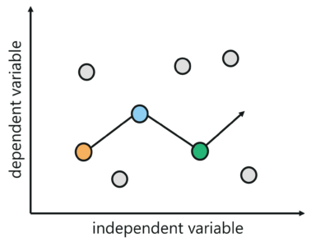
Methdology and Algorithms(cont..)
LASSO REGRESSION

Slide 13
Methodology and Algorithm(cont..)
Random Forest:-
Random Forest is a popular machine learning algorithm that belongs to the supervised learning technique.
It can be used for both Classification and Regression problems in ML.
It is based on the concept of ensemble learning, which is a process of combining multiple classifiers to solve a complex problem and to improve the performance of the model.
Random Forest is a classifier that contains a number of decision trees on various subsets of the given dataset and takes the average to improve the predictive accuracy of that dataset.

Slide 14
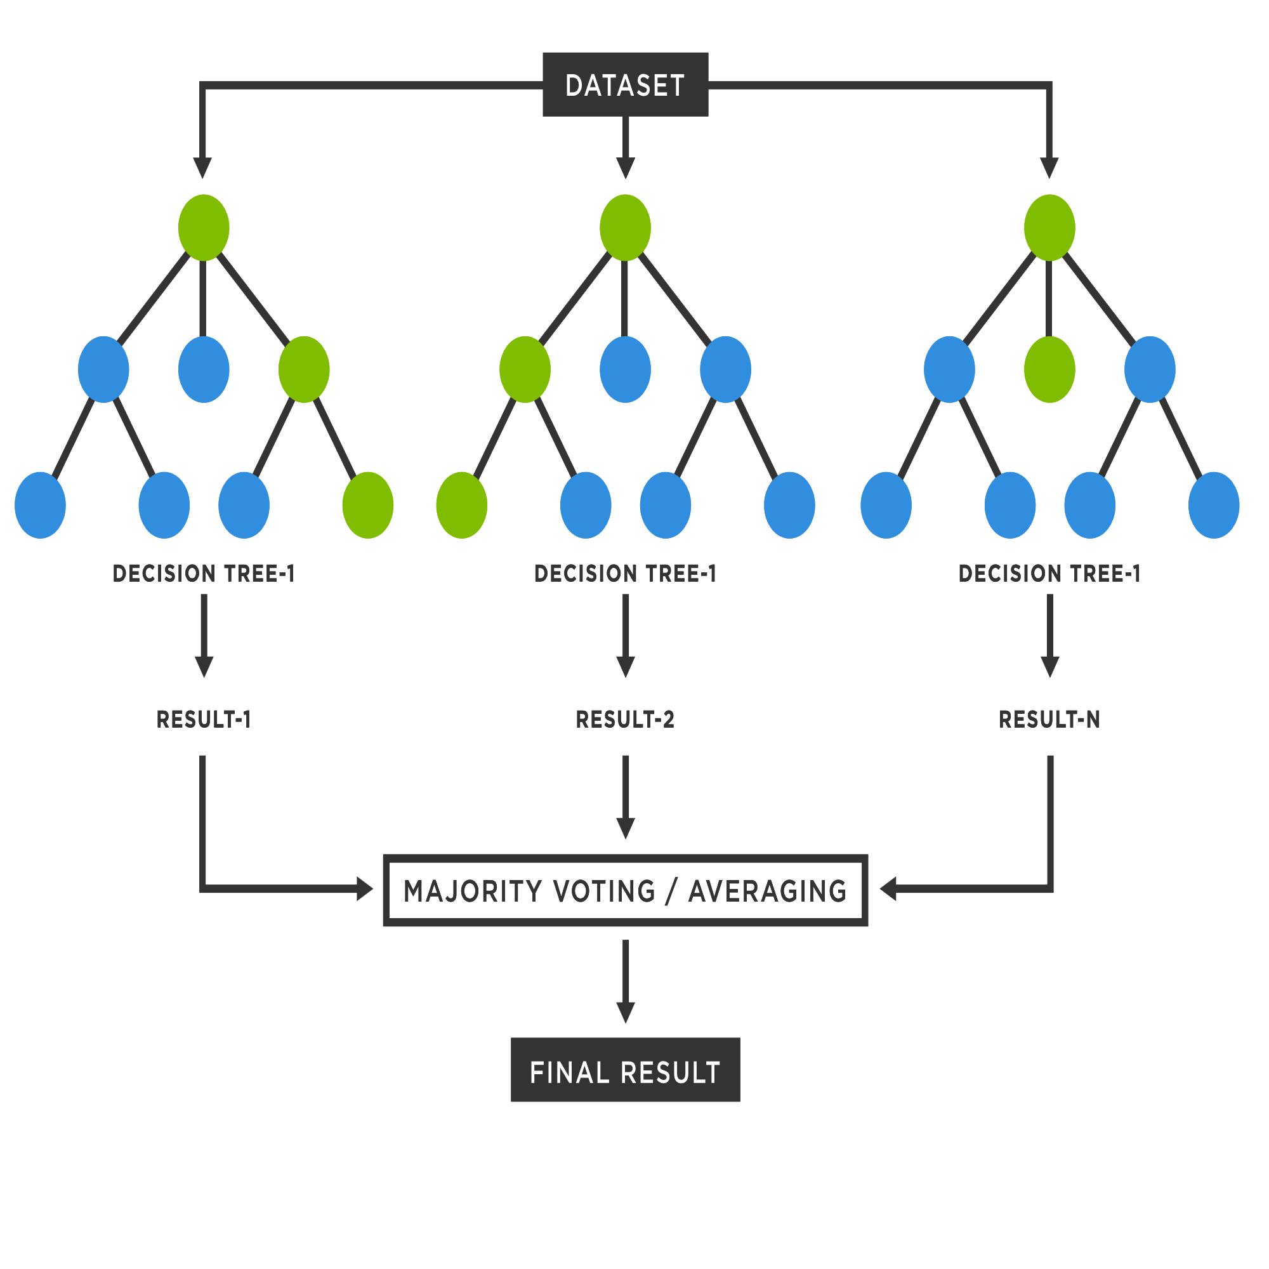
Methodology and Algorithm(cont..)
Random Forest:-

Slide 15
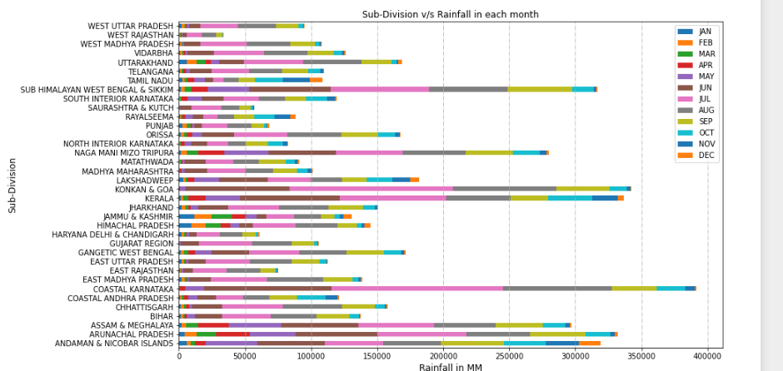
Snapshots of the Rainfallmodel

Slide 16
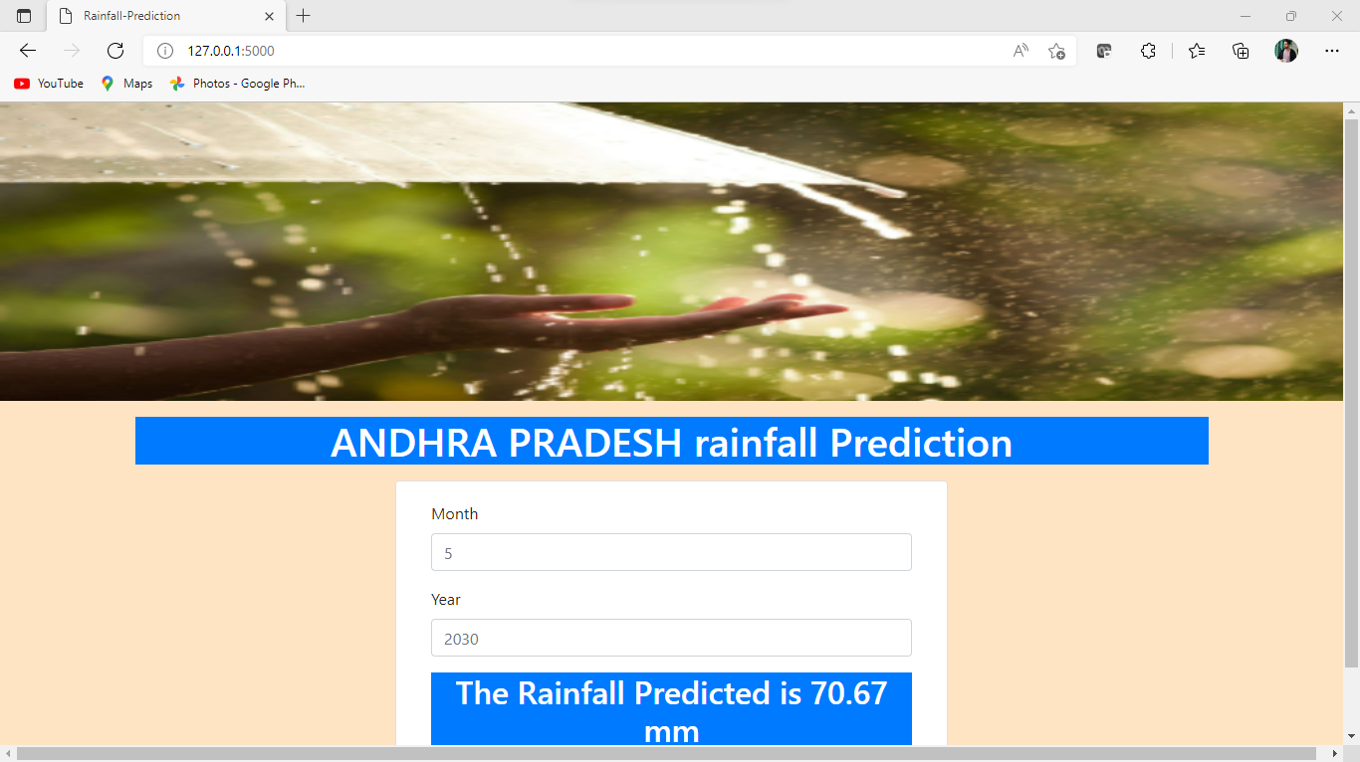
Snapshots of the Rainfallmodel
Feature importance score of the model

Slide 17
Results and Discussion
THE MAE,MSE,RMSE,Training Accuracy and Testing Accuracy values for Rainfall Prediction Using LINEAR REGRESSION
TEST DATA RAINFALL MODEL
MAE: 36.693305772295616
MSE: 2707.377549592384
RMSE: 52.032466303187896
TRAIN DATA OF RAINFALL MODEL
MAE: 37.684332030035904
MSE: 3113.2867829842517
RMSE: 55.79683488321046
TRAINING ACCURACY RAINFALL MODEL=41.69999992
TESTING ACCURACY RAINFALL MODEL=31.500

Slide 18
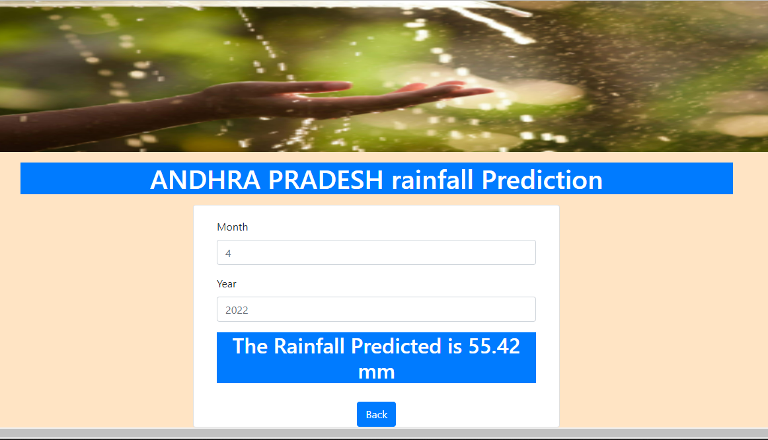
Performance Analysis Of Rainfall Prediction
Prediction of our Model :
predicted = random_forest_model.predict([[2022,4]])
Finally Predicted value = 54.30747745 ~ 55.42

Slide 19
Conclusion
In this project i used LINEAR REGRESSOR,LASSO REGRESSOR and Random forest Regressor as algorithms for the rainfall dataset.
I come to note that RANDOM FOREST REGRESSOR is far better than remaining two algorithms it terms of calculating accuracy results.
I also created GUI screens using HTML and CSS so that my project become userly friendly.
In future we try to upgrade our dataset and tried more different algorithms on our model.

Slide 20
References
[1] Breiman, L. (1998a). Arcing classifiers (discussion paper). Annals of Statistics, 26, 801–824. Google Scholar
[2] Breiman. L. (1998b). Randomizing outputs to increase prediction accuracy. Technical Report 518, May 1, 1998, Statistics Department, UCB (in press, Machine Learning).
[3] Breiman, L. 1999. Using adaptive bagging to debias regressions. Technical Report 547, Statistics Dept. UCB.
[4] Breiman, L. 2000. Some infinity theory for predictor ensembles. Technical Report 579, Statistics Dept. UCB.
[5] Freund, Y. & Schapire, R. (1996). Experiments with a new boosting algorithm, Machine Learning: Proceedings of the Thirteenth International Conference, 148–156.

Slide 21


